Slide 1
FrontEnd - Development
Pravin Y Pawar

Slide 2
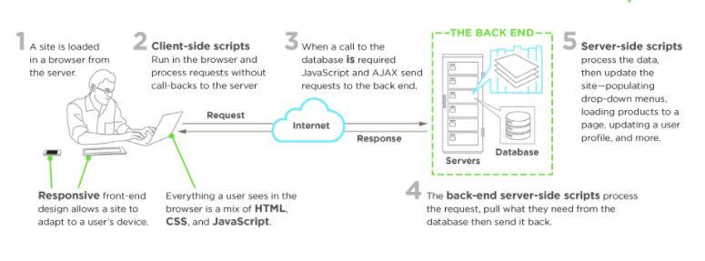
Typical Development scenario
A front-end developer
architects and develops websites and applications using web technologies (i.e., HTML, CSS, DOM, and JavaScript)
which run on the web platform or act as compilation input for non-web platform environments (i.e., NativeScript)
Image Source : upwork

Slide 3
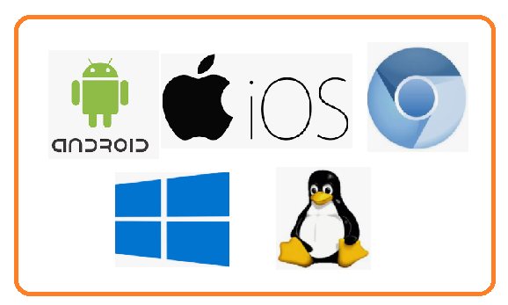
Role of a front end developer
A front-end developer crafts HTML, CSS, and JS that typically runs on the web platform (e.g. a web browser) delivered from one of the following operating systems (aka OSs):
Android
Chromium
iOS
Ubuntu (or some flavor of Linux)
Windows
These operating systems typically run on one or more of the devices:
Desktop computer
Laptop / netbook computer
Mobile phone
Tablet
TV
Watch
Things (i.e., anything you can imagine, car, refrigerator, lights, thermostat, etc.)

Slide 4
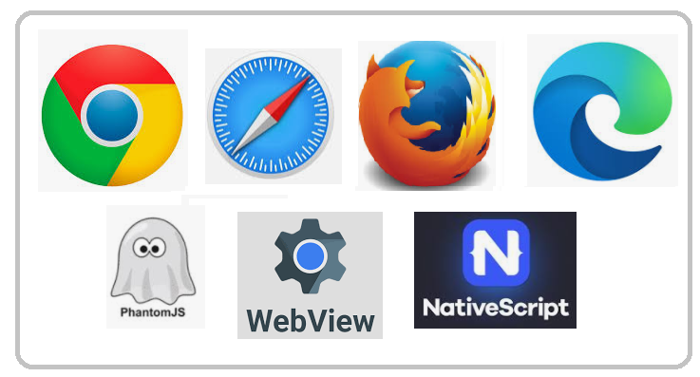
Web Platform
Front-end technologies can run on the aforementioned operating systems and devices using the following run time web platform scenarios:
A web browser (examples: Chrome, IE, Safari, Firefox).
A headless browser (examples: phantomJS).
A WebView/browser tab
A native application

Slide 5

Web Platform
Web Browsers
Is software used to retrieve, present, and traverse information on the WWW
Typically run on a desktop or laptop computer, tablet, or phone,
but as of late a browser can be found on just about anything (i.e., on a fridge, in cars, etc.).
The most common web browsers are (shown in order of most used first):
Chrome
Internet Explorer
Firefox
Safari

Slide 6

Web Platform
Headless Browsers
Are a web browser without a graphical user interface t
that can be controlled from a command line interface programmatically
Used for the purpose of web page automation
e.g., functional testing, scraping, unit testing, etc.
Think of headless browsers as a browser that can be run from the command line that can retrieve and traverse web pages
The most common headless browsers are:
PhantomJS
slimerjs
trifleJS

Slide 7

Web Platform
Webviews
Are used by a native OS, in a native application, to run web pages
Think of a webview like an iframe or a single tab from a web browser that is embedded in a native application running on a device
e.g., webviews iOS, android, windows
The most common solutions for webview development are:
Cordova (typically for native phone/tablet apps)
NW.js (typically used for desktop apps)
Electron (typically used for desktop apps)

Slide 8

Web Platform
Native from Web Tech
Web browser development can be used by front-end developers to craft code for environments that are not fueled by a browser engine
Development environments are being dreamed up that use web technologies (e.g., CSS and JavaScript), without web engines, to create native applications
Some examples of these environments are:
NativeScript
React Native

Slide 9
Thank You!
In our next session:

